Slide 1
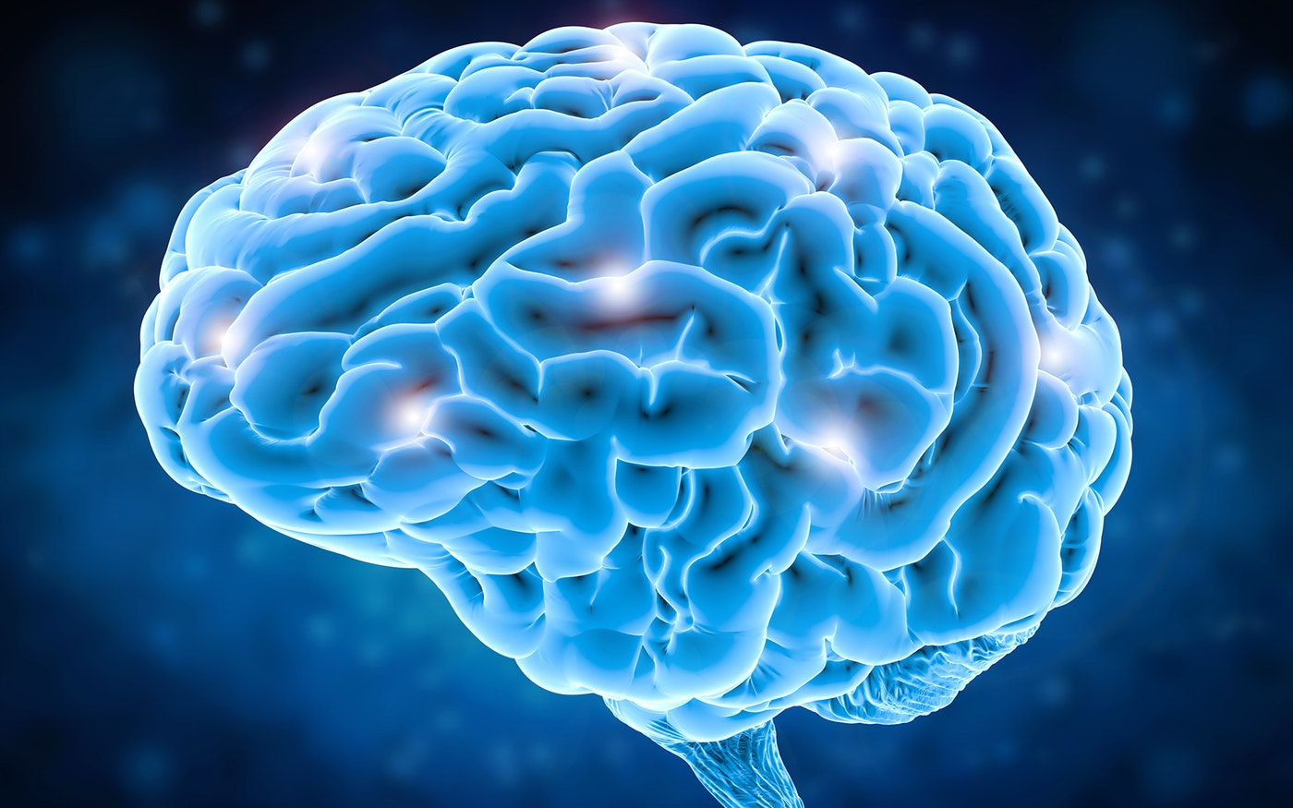
Brain tumor segmentation with Deep Neural Networks
Presented By:
Bar Ettedgui
Yuval Buchsweiler
Medical Image Analysis - January 2017
_______________________________________________________________________________________________________________________________
Mohammad Havaei, Axel Davy, David Warde-Farley, Antoine Biard , Aaron Courville , Yoshua Bengio , Chris Pal , Pierre-Marc Jodoina , Hugo Larochellea
__________________________________________________________________________________________________________________________
UniversitédeSherbrooke,Sherbrooke,Qc,Canada, École Normale supérieure, Paris, France, Universitéde Montréal, Montréal, Canada, École polytechnique, Palaiseau, France e École Polytechnique de Montréal, Canada

Slide 2
Motivation & Problem Statement
Notes:
אחריות ראם

Slide 3

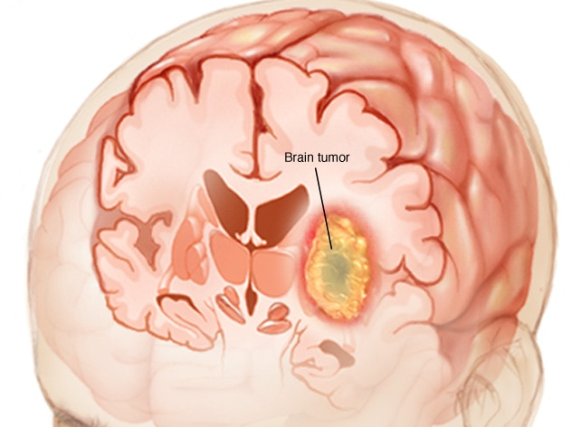
Notes:
Brain tumors are categorized into primary and secondary tumor types. Primary brain tumors originate from brain cells, whereas secondary tumors metastasize into the brain from other organs. The most common type of primary brain tumors are gliomas, which arise from brain glial cells. Gliomas can be of low-grade (LGG) and high-grade (HGG) subtypes. High grade gliomas are an aggressive type of malignant brain tumor that grow rapidly, usually require surgery and radiotherapy and have poor survival prognosis.

Slide 4
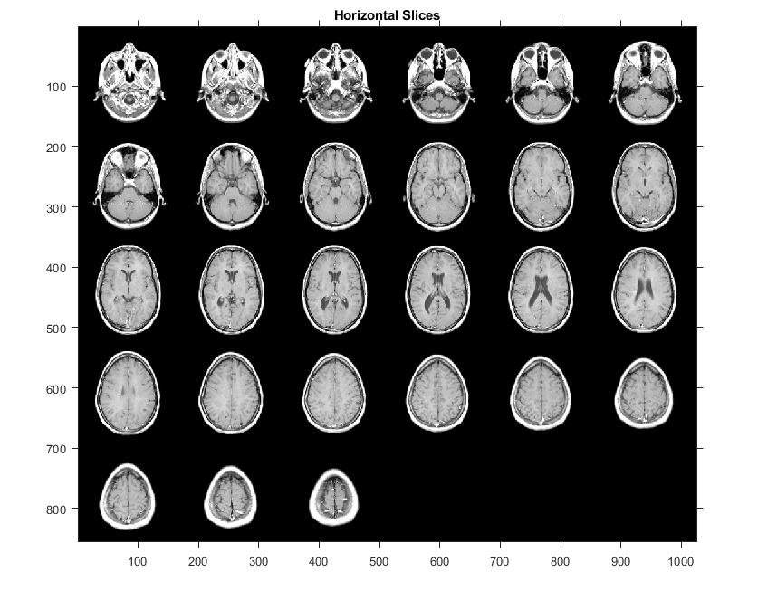
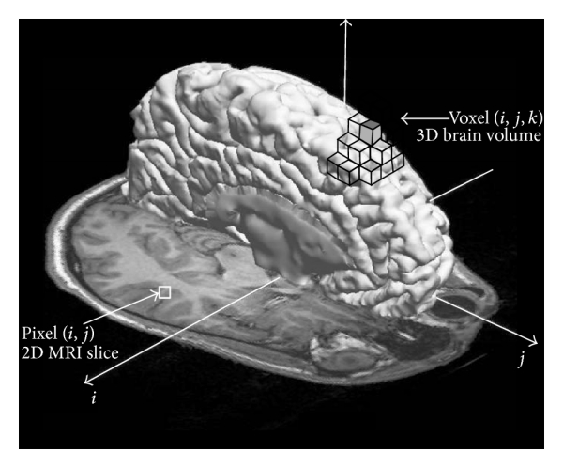
Notes:
Magnetic Resonance Imaging (MRI) is a key diagnostic tool for brain tumor analysis, monitoring and surgery planning. Usually, several complimentary 3D MRI modalities are acquired - such as T1, T1 with contrast agent (T1c), T2 and Fluid Attenuation Inversion Recover (FLAIR) - to emphasize different tissue properties and areas of tumor spread. For example the contrast agent, usually gadolinium, emphasizes hyperactive tumor subregions in T1c MRI modality.

Slide 5

Average Radiologist Salary
334,442$/year
MRI Brain Scan
155/slices * 4/modalities
620/images per patient
3 hours per patient
Or
30 sec using AI
Detection of brain tumor is critical in cases where survival of a subject depends on an accurate and timely clinical diagnosis
Notes:
Automated segmentation of 3D brain tumors can save physicians time and provide an accurate reproducible solution for further tumor analysis and monitoring

Slide 6
Previous work

Slide 7
Classic vision and
Beginning of CNN
3D DNN
2017
2D/3D patch CNN
ICBM brain atlas
Hand crafted features
3DUnet + VAE
3DUnet with additional data
DenseNet + Unet
2019
3D DNN
Ensemble of several models
Encoder Decoder with Cascaded architectures
The Future
past
2018
On going competition

Slide 8
The Data

Slide 9
Train dataset: BrasTS 2013 – 30 Patients
155 Slices per patient (240x240 pixels)
4 modalities (T1, T1CE, T2, Flair) and a label mask
4 labels: 0 – non tumor, 1 – necrotic, 2 – edema, 4 – high grade tumor.
NIFTI images (Neuroimaging Informatics Technology Initiative(
Unnormalized images
10 LGG (most not containing enhanced tumor)
20 HGG
6 random brains from BraTS2019
Validation Dataset:
Notes:
Each image is comprised of 4 co-registered NIFTI images of
Each pixel in the mask receives one of

Slide 10
Imbalanced data - BraTS2013 Dataset
Highly imbalanced dataset
Approximately 98.82% of voxels are of non-tumor tissue (label 0)
The remaining 1.18% are comprise of pathological voxels:
0.28% belong to necrosis (label 1)
0.68% to edema (label 2)
0.22% to enhanced tumor (label 4)

Slide 11
The Method

Slide 12
The Data
30 Brains Total
Pre-Processing
N4ITK bias field correction
Architecture
Input-Cascade CNN
Training and Optimization
Clip pixel intensities
Normalization
Augmentations
Patch cropping
DenseNet Block
Two-Pathway Block
ResNet Block
Training procedures
20 HGG
10 LGG
Format NIFTI
Pixel values - unnormalized
Optimizers (SGD Momentum, Adam)
Learning Rate (Scheduler, Cyclic)
Loss Functions
Randomization

Slide 13
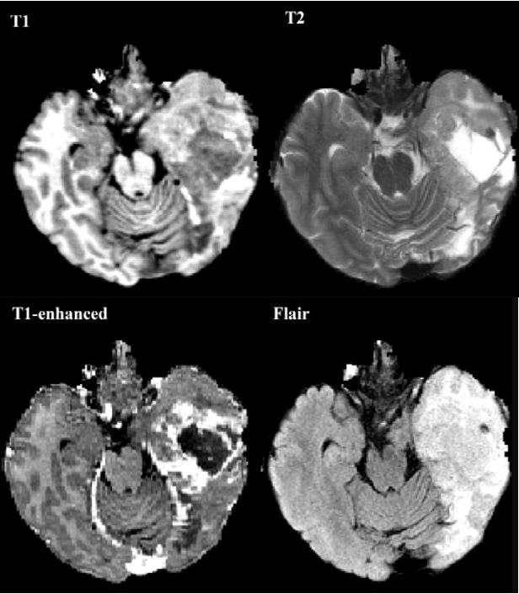
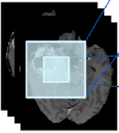
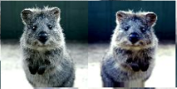
Pre-processing
N4ITK bias field correction
Clip pixel intensities
Normalization
Augmentations
Randomization
Correcting low frequency intensity non-uniformity caused by MRI machine
Outlier pixels are eliminated per brain, per channel
Enhances contrast between pixels
Patch cropping
Cropping patches with equal probability from all classes, skipping non-brain patches
Skipping black slices
Skip black slices to reduce number of background pixels
Normalizing pixel values per channel for each brain between 0 and 1
Using augmentation with probability 0.5, flips and 90-degree rotations on patches
Creating batches of patches with full randomization between brains, slices and center pixels.

Slide 14
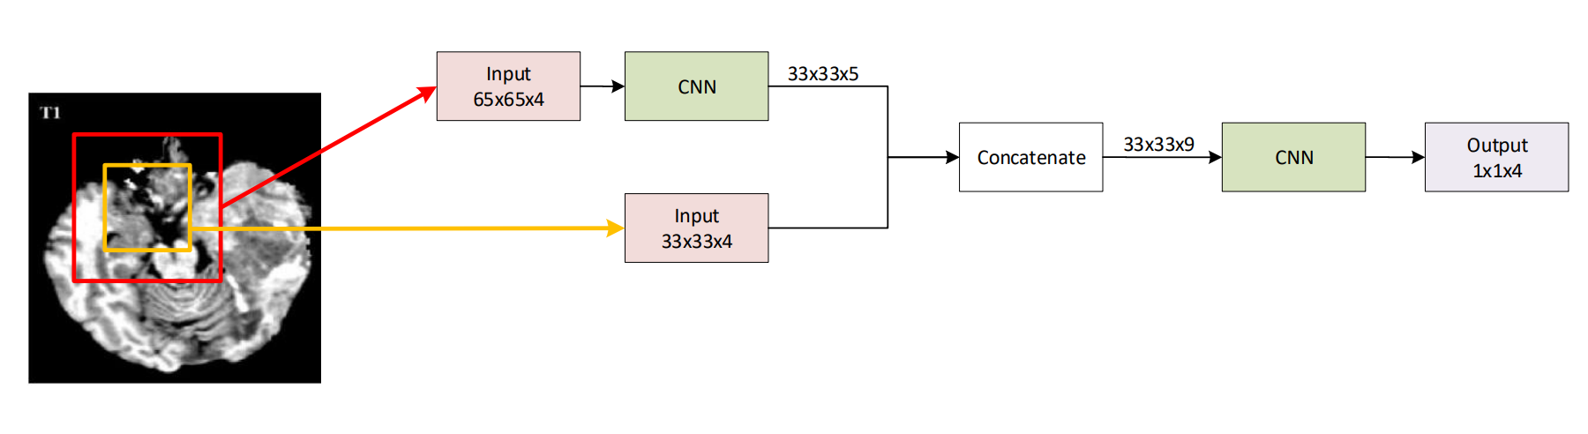
architecture
Cascaded CNN

Slide 15
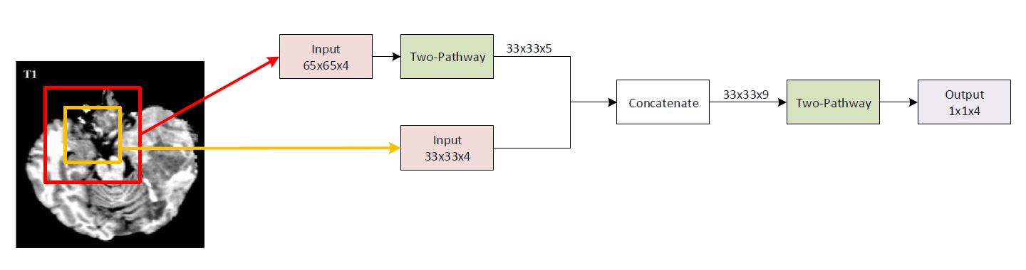
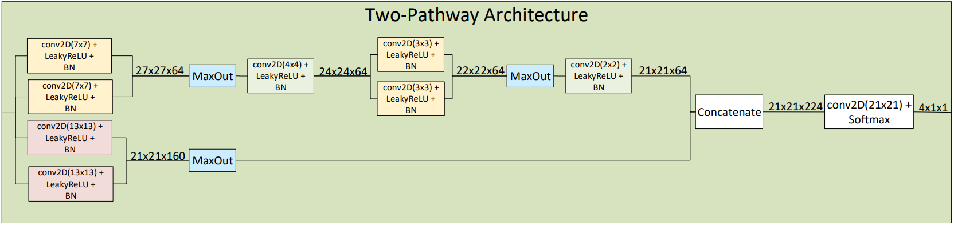
architecture
Cascaded CNN
Two-Pathway
Total params: 1,991,997
Trainable params: 1,989,171
Non-trainable params: 2,826
Depth: 10
Convolution padding: “valid”
Activation: MaxOut, LeakyReLU, Softmax

Slide 16
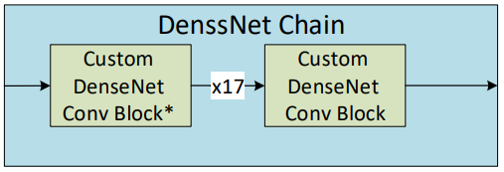
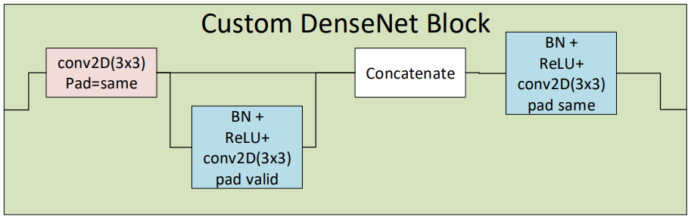
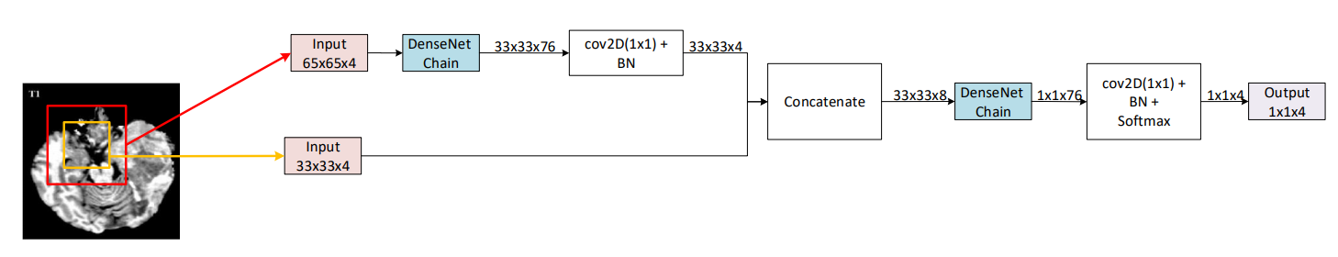
architecture
Cascaded CNN
Same-DenseNet
Total params: 1,278,656
Trainable params: 1,272,928
Non-trainable params: 5,728
Depth : 102
Num of conv layers:102
Convolution padding: “valid”, ”same”
Activation: ReLU, Softmax

Slide 17
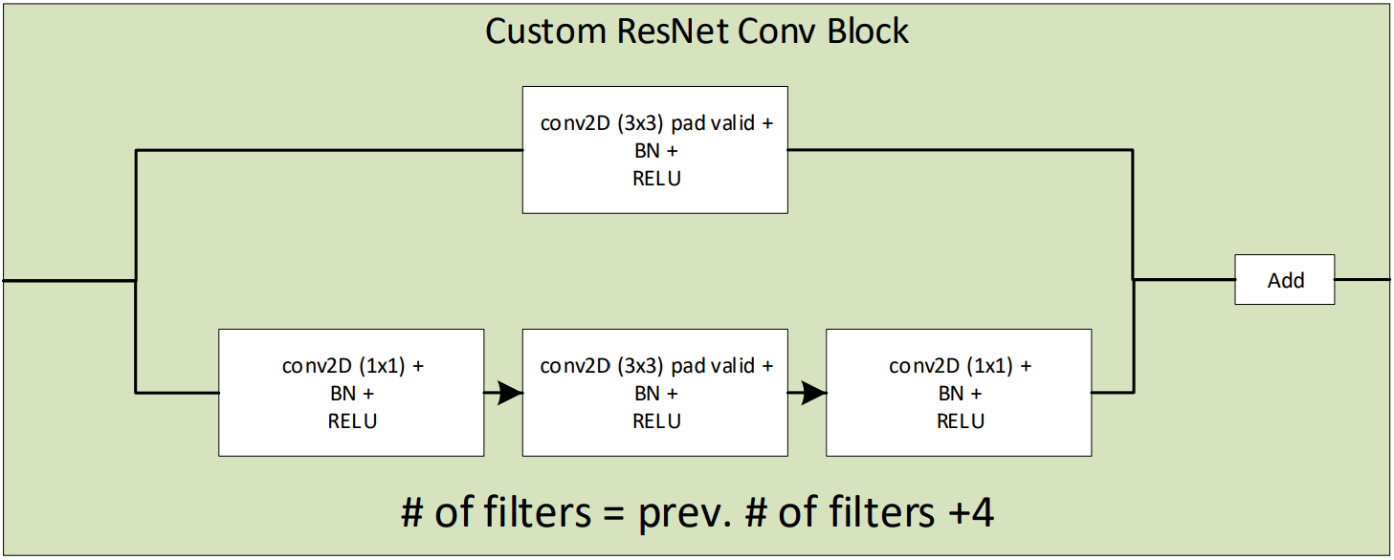
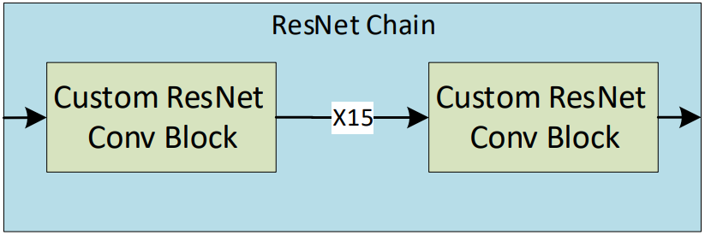
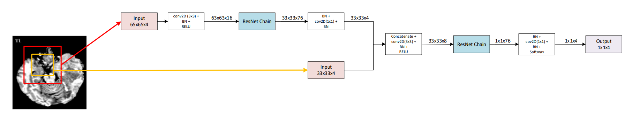
architecture
Cascaded CNN
Total params: 1,422,840
Trainable params: 1,414,600
Non-trainable params: 8,240
Num of conv layers: 124
Depth: 94
Convolution padding: “valid”, ”same”
Activation: ReLU, Softmax
Same-ResNet

Slide 18
Training & optimization
Training procedure
2 phase
End to end
Optimizers
SGD Momentum
Learning Rate
Cyclic LR
Schedule decay
Loss function
Adam
Exponential Decay
Cosine
Triangular
Weighted Categorical cross entropy
Weighted DICE loss
Jaccard loss + Categorical cross entropy
Metrics
DICE score per class
Average DICE
Categorical Accuracy

Slide 19
Results and Discussion

Slide 21
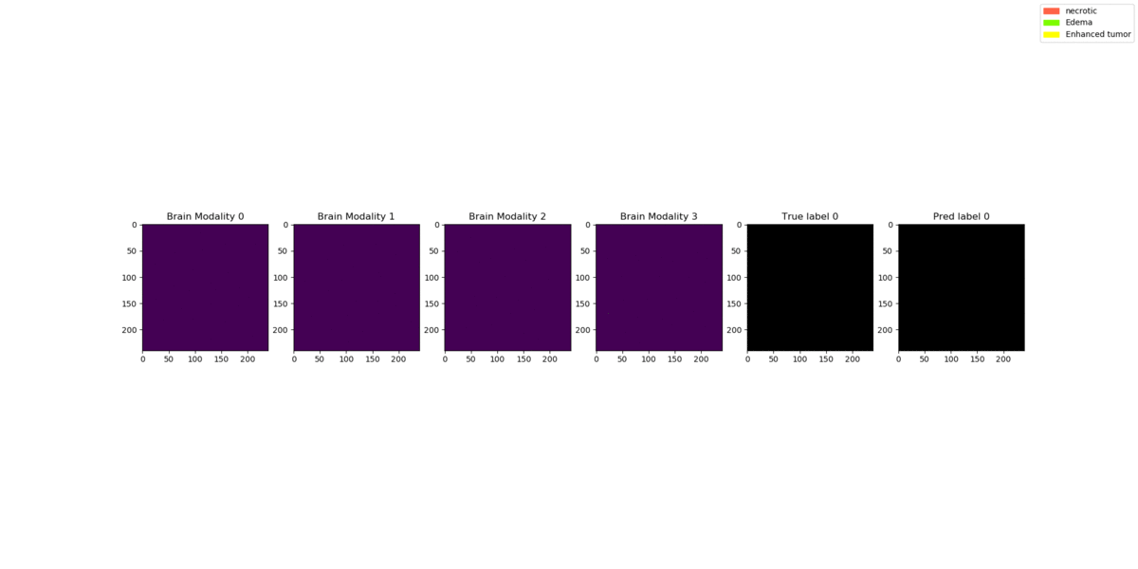
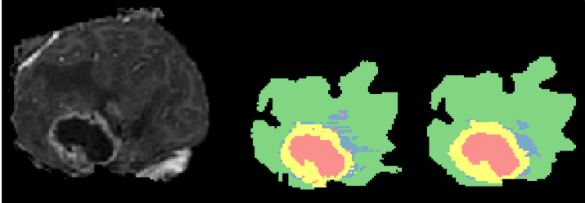
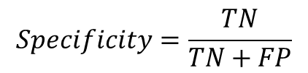
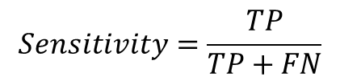
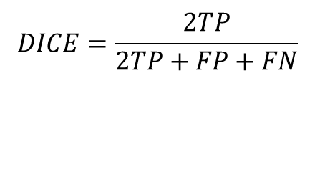
$$DICE=\frac{2TP}{2TP+FP+FN}$$
$$Specificity=\frac{TN}{TN+FP}$$
$$Sensitivity=\frac{TP}{TP+FN}$$
Method | DICE |  |  | Specificity |  |  | Sensitivity
 | complete | core | enhancing | complete | core | enhancing | complete | core | enhancing
InputCascadeCNN | 0 .88 | 0 .79 | 0 .73 | 0 .89 | 0 .79 | 0 .68 | 0 .87 | 0 .79 | 0 .80
Two-Path Cascaded | 0.86 | 0.80 | 0.72 | 1 | 1 | 1 | 0.81 | 0.78 | 0.77

Slide 22

Thank you!
Present By:
Bar Ettedgui
Yuval Buchsweiler

